Slide 1
Prejudice in Neural Network Embeddings
joel ellery baines

Slide 2


Some Basics
Machine Learning Goals:
Bias refers to prior information, a necessary prerequisite for intelligence.
Bias is identical to meaning.
Human language contains bias.
Human vision contains bias.
Unacceptable and/or harmful bias is prejudice
AI should always be applied transparently, and without prejudice
“Computation derived from mathematics would be pure and neutral, providing for AI a fairness beyond what is present in human society.”
[2] Semantics derived automatically from language corpora necessarily contain human biases ~ Caliskan et al (2017)
Notes:
Consider a straw-man sentiment analysis technique based on word embeddings: calculate the valence of each word based on its association with designated positive and negative words, then sum up the sentiment scores. Now consider applying this technique to movie reviews. Our results show that European-American names have more positive valence than African-American names in a state-of-the-art word embedding. That means a sentence containing a European-American name will have a higher sentiment score than a sentence with that name replaced by an African-American name. In other words, the tool will display a racial bias in its output based on actor and character names.
Google Translate converts these Turkish sentences with genderless pronouns: “O bir doktor. O bir hems¸ire.” to these English sentences: “He is a doctor. She is a nurse.” shows that the pronoun is translated to “he” in the majority of cases and “she” in about a quarter of cases; tellingly, we found that the gender association of the word vectors almost perfectly predicts which pronoun will appear in the translation.

Slide 3
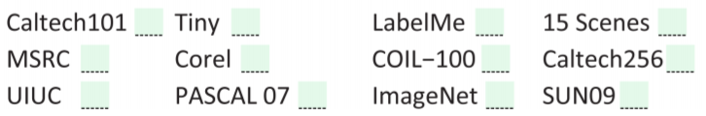
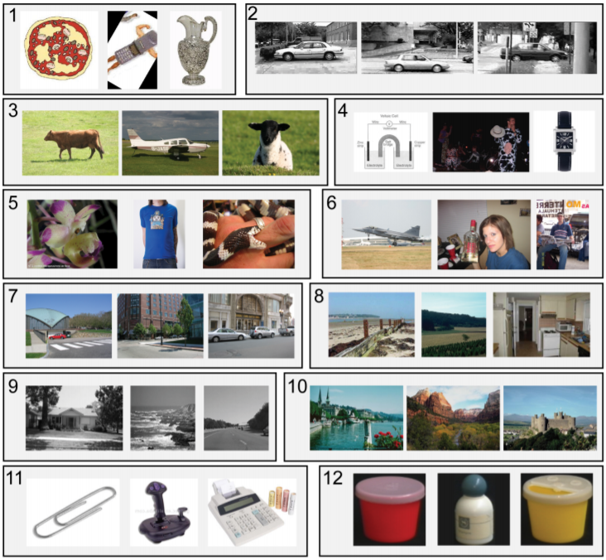
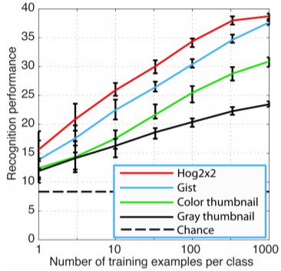
Dataset Bias
Name That Dataset!
Randomly sampled 1000 images from the training portions of each of the 12 datasets, and trained a 12-way linear SVM classifier. The classifier was tested on 300 random images from each of the test sets, repeated 20 times.
1) Caltech-101, 2) UIUC, 3) MSRC, 4) Tiny Images, 5) ImageNet,
6) PASCAL VOC, 7) LabelMe, 8) SUNS-09, 9) 15 Scenes, 10) Corel,
11) Caltech-256, 12)COIL-100
[8] Unbiased Look at Dataset Bias ~ Torralba et al (2011)
Notes:
SVM = support vector machine, used for regression or supervised learning, used for classifications

Slide 4
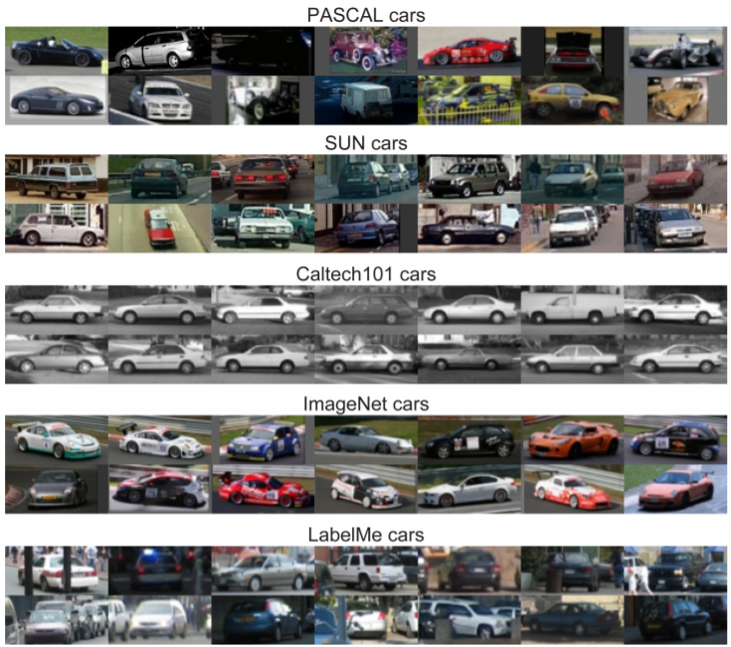
Dataset Bias
Major types of bias:
Selection Bias
Capture Bias
Negative Set Bias
Should we care about the quality of our datasets?
“If the goal is to reduce computer vision to a set of feature vectors that can be used in some machine learning algorithm, then maybe not. But if the goal is to build algorithms that can understand the visual world, then, having the right datasets will be crucial.”
Do datasets have strong built in bias?
YES!
[8] Unbiased Look at Dataset Bias ~ Torralba et al (2011)
Notes:
SVM = support vector machine, used for regression or supervised learning, used for classifications

Slide 5
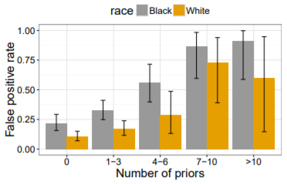
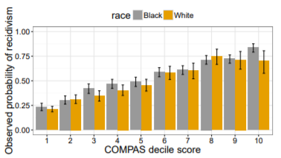
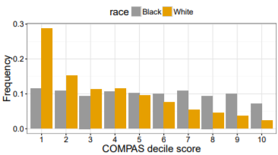
Consequences of Linguistic Prejudice
Recidivism prediction instruments
Used in pre-trial decision-making, parole decisions, and evening sentencing
“Initial findings suggesting that there is evidence of predictive bias when it comes to gender, but not when it comes to race”
“...the differences in false positive and false negative rates... are a direct consequence of applying an instrument that is free from predictive bias to a population in which recidivism prevalence differs across groups
[6] Fair prediction with disparate impact: A study of bias in recidivism prediction instruments ~ Chouldechova et al (2016)

Slide 6
Facial Recognition:
What is being done?
The Perpetual Line-Up
5 - 10% less accurate for African Americans & Women
“Does not see race”
No test in place for racial prejudice
Overused on specific portions of population
Overrepresented specific portions of population
Final selections can be human based
[13] The Perpetual Line-Up ~ Georgetown Law 2018
Notes:
The companies tested include the suppliers of algorithms to the Los Angeles County Sheriff, the Maryland Department of Public Safety, the Michigan State Police, the Pennsylvania Justice Network, and the San Diego Association of Governments (SANDAG), which runs a system used by 28 law enforcement agencies within San Diego County.

Slide 7
Utilizing Bias
Criminal Justice
Fair prediction with disparate impact: A study of bias in recidivism prediction instruments ~ Chouldechova et. al. (2018)
Advertising
Discrimination in Online Ad Delivery Google ads, black names and white names, racial discrimination, and click advertising ~ Sweeney (2013)
News
Detecting and Identifying Bias-Heavy Sentences in News Articles ~ Hirning et. al. (2017)
Evaluating Weightless Neural Networks for Bias Identification on News ~ Cavalcanti. et. al. (2017)
Scholarly Articles
Detecting Latent Ideology in Expert Text: Evidence From Academic Papers in Economics ~ Jelveh (2014)
Gaydar
Deep neural networks are more accurate than humans at detecting sexual orientation from facial images ~ Wang et al (2017)

Slide 8




Avoid Physiognomy
“Like computers or the internal combustion engine, AI is a general-purpose technology that can be used to automate a great many tasks, including ones that should not be undertaken in the first place.”
Makeup
Eyeshadow
Facial hair
Glasses
Selfie angle
Amount of sun exposure
[12] Do algorithms reveal sexual orientation or just expose our stereotypes? ~ Aguera et al (2018)

Slide 9
Dataset Bias:
What to do?
Consider bias
Improve features
Automate collection
Multiple sources
Increase the training size
Crowd-sourcing
Test negative bias
[8] Unbiased Look at Dataset Bias ~ Torralba et al (2011)
Notes:
The increase in training data must be very significant if we add training data that does not match the biases of the test data this will result in a less effective classifier.
Obtaining data from multiple sources (multiple search engines from multiple countries) can somewhat decrease selection bias

Slide 10
Future Research
Physiognomy
Debiasing, without ‘fairness through blindness’
Increased collaboration between engineers and domain experts
Diversity among developers
Proxy variables
Casual reasoning in AI
Notes:
Avoid Debiasing as “fairness through blindness”

Slide 11
“Like computers or the internal combustion engine, AI is a general-purpose technology that can be used to automate a great many tasks, including ones that should not be undertaken in the first place.”
Questions?
“If the goal is to reduce computer vision to a set of feature vectors that can be used in some machine learning algorithm, then maybe not. But if the goal is to build algorithms that can understand the visual world, then, having the right datasets will be crucial.”

Slide 12
Citations
Unbiased Look at Dataset Bias ~ Torralba et al (2011)
Semantics derived automatically from language corpora necessarily contain human biases ~ Caliskan et al (2017)
Fair prediction with disparate impact: A study of bias in recidivism prediction instruments ~ Chouldechova et al (2016)
The Perpetual Line-Up ~ Georgetown Law (2018)
Do algorithms reveal sexual orientation or just expose our stereotypes? ~ Aguera et al (2018)
Deep neural networks are more accurate than humans at detecting sexual orientation from facial images ~ Wang et al (2017)
Detecting and Identifying Bias-Heavy Sentences in News Articles ~ Hirning et. al. (2017)
Evaluating Weightless Neural Networks for Bias Identification on News ~ Cavalcanti. et. al. (2017)
Detecting Latent Ideology in Expert Text: Evidence From Academic Papers in Economics ~ Jelveh (2014)
Discrimination in Online Ad Delivery Google ads, black names and white names, racial discrimination, and click advertising ~ Sweeney (2013)

Slide 13
Outline & Notes
Title -
Set 1, OBS & INH
1 -
2 -
3 -
Set 2, HARMS
1 -
2 -
3 -
Set 3, SOL
1 -
2 -
3 -
End

Slide 14
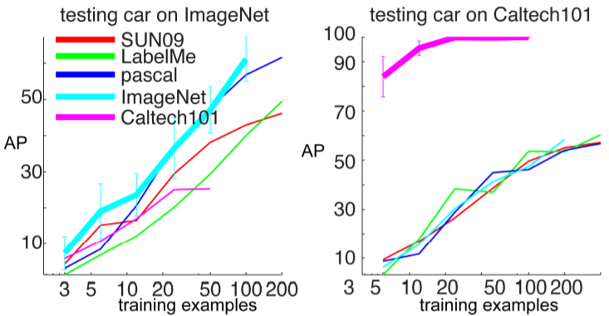
Negative Bias

